Slide 1
Apricot Certification Exam:
Prep Course
Notes:
Speaker Notes:
Welcome! Thank you for joining our Apricot Certification Exam Prep course.
This is a 2 hour session designed to set you up for success with our exam.
We will go over what to expect, some key areas of competency and then have plenty of time for Q&A.

Slide 2
Meet Your Trainer
TRAINER NAME
TRAINER ROLE
ClientTrainingRequests@BonterraTech.com
Notes:
Speaker Notes:
Introduce yourself – Name and Role
Share how long you have been working at Bonterra or in a training capacity
Mention something you are looking forward to with this class

Slide 3
Agenda
Overview & Expectations
Competency Categories
Open Q&A
Recommended Training
Notes:
Speaker Notes:
Here is a look at our agenda
We will start with an overview of the exam and some expectations so you know more about what you’ve signed up for.
We’ll spend a bit of time going through the key areas you need to understand as an Apricot Admin to pass the exam.
We will highlight some training recommendations so you can confirm if you are ready or if you want to complete any refreshers.
Then lastly we will open it up to Q&A so you have time to tie up any loose ends before you test your knowledge.

Slide 4
Exam Overview & Expectations
Notes:
Speaker Notes:
Let’s start with a review of what this certification exam entails and what you can expect.

Slide 5
Exam Overview
Access
Questions
Reference
Scoring
Retake
Recertification
Free Online Exam, hosted in Bonterra Academy
50 Multiple Choice & True / False
Use Help Center & Apricot as needed
Graded in Real Time; Passing is 90%
Option to Retake Once after 7 Day Wait if Score <90%
Mini Quiz to be taken Bi-Annually
Notes:
Lesson: Overview of what the exam entails and how to pass.
Speaker Notes:
*Animation to reveal each component.
In terms of access, this exam is free to any Apricot users, though recommended for Admins. You will take it online via our Bonterra Academy. We will have a signup to register whether you already have an account or need one.
When it comes to questions, the initial exam is a mix of 50 multiple choice and True / False. While you won’t have to complete any practical exercises, many of the questions were created with real life scenarios in mind.
You are welcome to reference any materials you need while taking the exam like the Help Center or your Apricot instance. Consider it open book. Knowing how to find the answer is often as valuable as having it memorized.
The exam is automatically graded as you submit it, so you will know it real time if you passed. You must get at least 90% of the questions correct.
If you do not pass on the first go, we will allow for one retake. You will have a 7 day wait before the exam becomes available again, so feel free to use that time to brush up on anything you missed.
Once you pass, you will receive a digital badge and to maintain that, we just ask that you take our recertification exam every 6 months to make sure you are keeping up to date with new releases and such. This will be a shorter 5-10 question quiz to confirm.

Slide 6

Exam Expectations
Digital Badge awarded upon passing score.
Software Certification is valid for 6 months.
Must take bi-annual recertification quiz to maintain.
Quizzes will be 5-10 questions on recent releases.
Monthly new release webinars for ongoing training.
Impact Management Monthly Newsletter & Product Updates Webinar
Notes:
Lesson: What happens after certification
Speaker Notes:
As mentioned, once you pass the exam you will receive a digital badge that you are welcome to share on LinkedIn, in your email signature, wherever you’d like to showcase your Apricot expertise.
This certification will remain up to date as long as you continue to pass our bi-annual quizzes on latest updates and releases.
We recommend signing up for our newsletter and joining our monthly release trainings to see what’s new.
LINK to Share: https://apricot-articles.socialsolutions.com/en/articles/9406409-impact-management-monthly-newsletter-product-update-webinars

Slide 7
Competency Categories
Notes:
Speaker Notes:
Now let’s get in to the meat of what you need to know to be successful on the exam.
We’ve outlined key areas of knowledge that we expect a certified Apricot Admin to have to be successful.
These topic areas are what we’ve drawn from for our 50 questions.

Slide 8
Competency Categories
Admin Role
Form Design
User Management
How to Track…
Data Management
Additional Features
Native Reporting
Notes:
Lesson: Overview of the main competency areas the exam will cover (deeper dive into each one to follow).
Speaker Notes:
Here is a look at the main areas you will be tested on.
In most cases, there is a foundation of knowledge needed and then the questions will be move advanced assuming you know the basics.
We will go into each of these in more detail in the following slides.
A certified Apricot Admin should be comfortable with:
Your role as the Admin for your organization.
How to design and manage forms for collecting data.
Best practices for tracking specific nonprofit use cases.
Building reports to analyze your data.
Managing users and their access in the system.
Managing your data to ensure quality and completeness.
And additional features available within Apricot as needed.

Slide 9

Admin Role
Implementation
Onboarding Staff
Ongoing Management & Maintenance
Initial Design & Configuration
Expert in Org’s Use & Needs
Build Forms, Reports, Roles, Bulletins, etc.
Launch Prep & Change Management
New User Training
Respond to & Adjust for Feedback
User Support & Oversight
Customer Support Liaison
Data Quality Assurance
Training for User Transitions
Configuration Adjustments
Notes:
Lesson: Overview of what we mean by the Admin Role.
Speaker Notes:
Starting with your Role as an Admin, there are several phases in which you will operate.
During Implementation, you will be the main point of contact for our Professional Services team to map out your organization’s needs and translate those into Apricot framework. You will become the expert in both your organization and Apricot. You will likely do a lot of building or customization to the pre-built forms, reports, etc.
When it’s time to launch your Apricot, you will play a key role in onboarding staff. This usually involves some change management, training and addressing any feedback surfaced to ensure the user experience is positive.
For the long term, you will be your team’s go to for all things Apricot. You will manage the system and ensure it’s being used well. You’ll apply any updates as we roll out new features or your organization’s needs change. You’ll be the contact for Support as you run into issues.
From a certification standpoint, the idea here is that you are comfortable with the expectations as an Admin and where to go to manage the various settings, configuration and elements that make for a functional database.

Slide 10

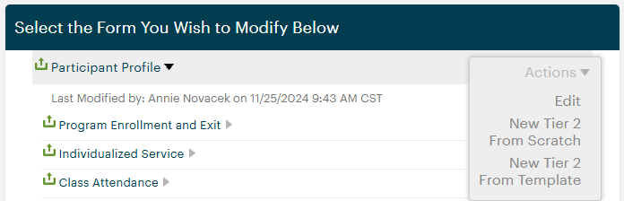
Form Design
Tier 1 vs. Tier 2 Forms
Tier 1 Profiles to identify individuals & track demographics, contact info, etc.
  Participants, Households, Volunteers
Tier 1 Forms to track interactions & activities for count / history / progress.
  Program Enrollments, Service Plans, Goals, Services Delivered, Assessments
Form Templates
Pre-build forms provided as starting point with data collection best practices.
Forms can be fully customized to unique needs.
Choose Tier 1 vs. Tier 2 placement wisely.
Start from scratch for anything fully custom.
Notes:
Lesson: Review of all the areas involved in designing forms that they need to know.
Speaker Notes:
Now let’s get into Form Design as this is a key component of data collection in Apricot.
It’s important that you understand the difference between Tier 1 and Tier 2 forms with the types of data each should collect.
We also want our Admins to know how to make use of pre-built templates to save time and take advantage of industry best practices.

Slide 11
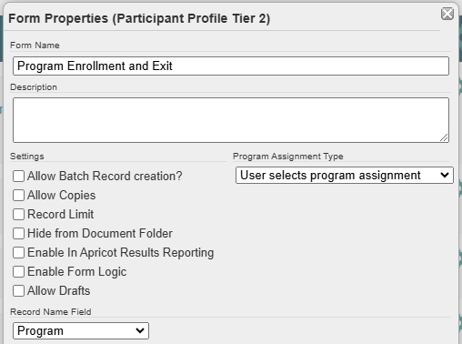
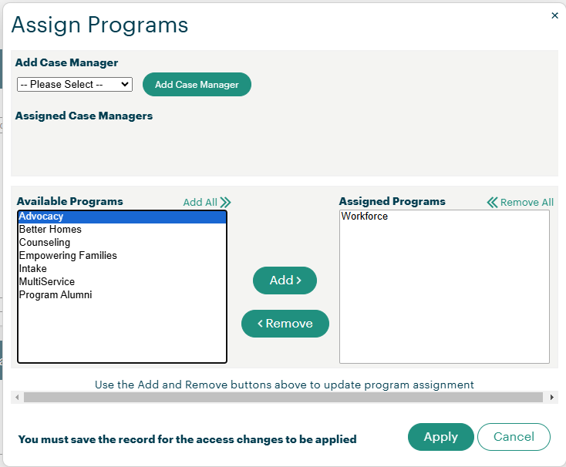
Form Design
Form Properties
Options & settings enabled for each form.
Record Program Assignment
User selects program assignment
Assign records to form’s associated programs
Assign records to user’s associated programs
Notes:
Lesson: Review of all the areas involved in designing forms that they need to know.
Speaker Notes:
You’ll need to know what you can enable at the form level in terms of properties and when each is a good idea such as Batch Record Creation, Record Copy, Form Logic, etc.
Program Assignment Type is it’s own area of potential with the 3 options that suit different use cases. This impacts data access, security and user workflow.

Slide 12
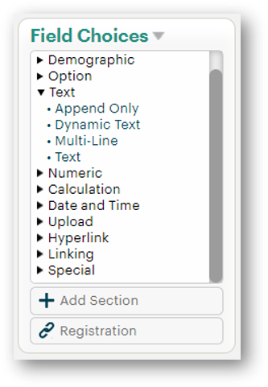
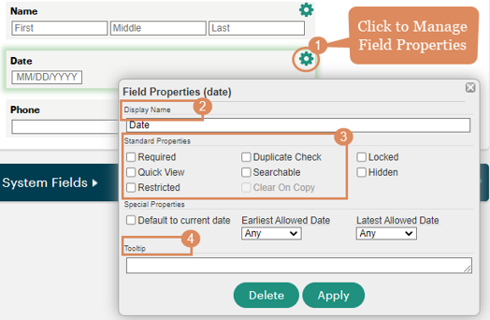
Form Design
Field Types
Choose the right type for data & reporting.
Data Format:
Date & Time
Numeric
Text
Field Format:
Preformatted
Option
Open Text
Field Properties
Settings & options for each data point.
Notes:
Lesson: Review of all the areas involved in designing forms that they need to know.
Speaker Notes:
For fields you add to your forms, it’s important to consider what type of data you are collecting and which field format will suit you best. This is especially key when it comes to being able to report back to your stakeholders. Is the data you’re collecting going to yield itself to statistical reporting?
Then you will need to be confident with the different field properties you can configure to ensure you are clear about each data point. How do you ensure your staff knows what data you are asking for and make the information easy to manage?

Slide 13
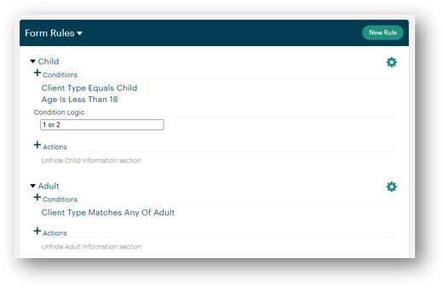
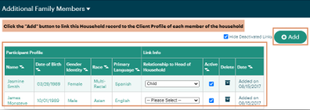
Form Design
Lookup Lists – Preset list of answer choices for Option fields to save time & ensure consistency.
Smart Fields – Dynamic list of answer choices based on data entered in another form in Apricot.
Linking Fields – Opportunity to connect data to improve workflow & enable combined reporting.
Form Logic – Option to automate actions within a form based on answers to certain questions.
Notes:
Lesson: Review of all the areas involved in designing forms that they need to know.
Speaker Notes:
A few other advanced components to consider:
Lookup lists to save you time and make your lists of answer choices more consistent.
Smart lists can be used as a dynamic option based on data you are collecting elsewhere in Apricot.
Make sure you understand the how and why of Linking Fields to show a relationship between records.
And Form Logic is a good way to uplevel your forms with some automation based on data entered.

Slide 14
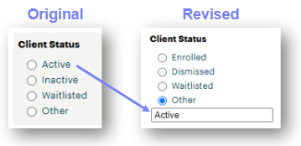
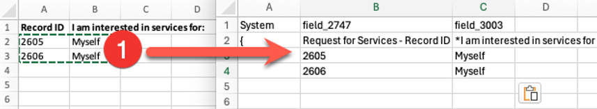
Form Design
Editing Forms
Ongoing maintenance to add, adjust or remove fields.
Always consider the impact on previously entered records.
Importing & Moving Data
Option to migrate data into Apricot or from one field to another via spreadsheets.
Must tell Apricot where to put data & avoid accidently overwriting anything.
Notes:
Lesson: Review of all the areas involved in designing forms that they need to know.
Speaker Notes:
Lastly, knowing that your Apricot will need to grow and evolve with your organization, it’s important you understand the nuances of editing forms and protecting any data that’s been entered.
This includes understanding our Data Import tool, whether you are uploading new information or moving data from one place to another within Apricot.

Slide 15

How to Track…
Demographics – Tier 1 Profile, updated as information changes.
Households – Tier 1 Profile linking together family members.
Services – Tips for single vs. multiservice like Wizard Style Linking.
Attendance – Classes & Terms vs. Batch Record Creation.
Referrals – Intake for Incoming, Referrals for Internal, Tier 2 for Outgoing.
Surveys / Assessments – Masked Value Fields & Calculations.
Inventory – Tracking Physical Resources, Distributions & Returns.
Notes:
Lesson: Overview of different use cases you need to know how to set up in Apricot.
Speaker Notes:
Building on how to design forms, there are common nonprofit data collection use cases we recommend knowing, each with options and specific features to meet different situations.
For example, Admins should understand how to collect and manage demographics at the Tier 1 profile level.
For organizations that work with or at least want to track families, there’s Household profiles.
Services are perhaps the most common when it comes to tracking the outputs you deliver to your Participants, and there are a variety of designs based on what type of services you deliver, how many per visit, etc.
When you host classes, events or any type of group activities, consider the different features Apricot offers to track attendance.
Knowing that it often takes a community effort to support some participants, we recommend being familiar with how you can handle different types of referrals.
Surveys and Assessments track a unique kind of data and Admins should know how to make the qualitative into quantitative results.
Then there is our newer Inventory feature for tracking physical goods, whether you are a shelter with beds or a food pantry.

Slide 16

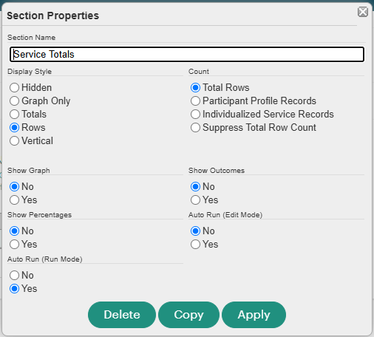
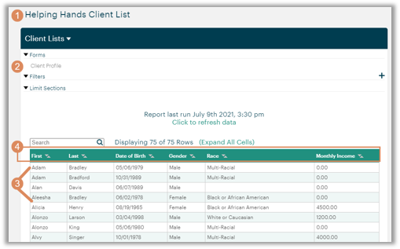
Native Reporting
Report Building
Drag & drop any data collected in your Apricot.
Start with the right root form for solid foundation.
Make sure report respects Linking relationships.
Section Properties
Options & settings to enable for each section.
Notes:
Lesson: Review key knowledge areas in reporting
Speaker Notes:
Now let’s get into reporting, specifically the tool available within Apricot itself (as opposed to Results Reporting which comes with Apricot 360).
Of course, you want to know the foundations of building reports in Apricot, how to drag and drop fields, starting with the right root form and adjusting the settings to accommodate any layers of complexity like linked records.
It’s also key to consider Section properties that allow you to change the display style, add a graph or copy the section to make a new version.

Slide 17
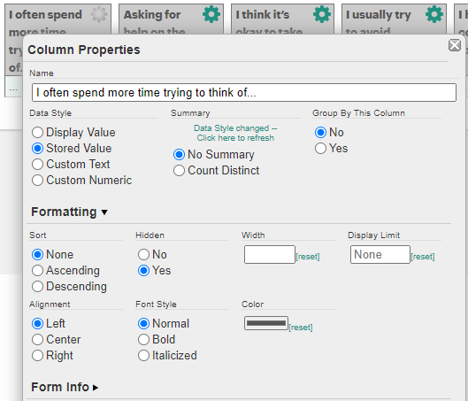
Native Reporting
Column Properties
Settings for each data point in a report.
Options vary by type of field & data.
Filtering
Use Global Filters with multi-section reports.
Use “Searchable” setting for common filters.
Apply Filter Logic for more advanced filtering.
Inverse Filter gives you everything but “xyz.”
Group Filters apply to Grouped data.
Comparison Filters work on to like datapoints.
Notes:
Lesson: Review key knowledge areas in reporting
Speaker Notes:
Then you have the different column properties with every data point you pull into your report, like display styles to convert the data in some way and Summaries to have Apricot do some initial analysis.
Filters are another area with lots of potential to help you make the most of your reporting by strategically focusing what data is included.

Slide 18
Native Reporting
Grouping – Organizing report data into categories for counts & analysis.
Graphing – Adding visual representation of compiled data for impact.
Special Columns – Calculation or Summary to analyze report rows & sections.
Summary Sections – Compile data points from other sections to summarize.
Limits & Required – Options to narrow down data by secondary form & creation date.
Linking Relationships – Ensuring accuracy when reporting on multiple forms.
When to Use Results – More robust reporting tool available with Apricot Enterprise (360).
Notes:
Lesson: Review key knowledge areas in reporting
Speaker Notes:
Other ways in which you can customize your reports and provide your stakeholders with more of a story of your impact:
Grouping allows Apricot to give you totals across different categories of data, especially great for Option fields.
Graphs add a nice visual element for understanding the data at a glance.
Special Columns come in to play with you want to apply math across a Row or pull summaries from individual sections.
Be sure to consider Summary Sections to compile data from different sections to tell a more complete story.
Getting into some more nuanced options we have limits to show just specific data like First or Last Created and the Required setting to help narrow down as you include more than one source of data in your report.
You should also be prepared to speak to when linking relationships matter in reports, such as linking Enrollments to Services so you know which Program a service was provided under.
Lastly, while we don’t expect you to be an expert in Results Reporting for this exam, it’s helpful to know when that tool might better help you reach your reporting goals as it’s more robust than Native reporting.

Slide 19

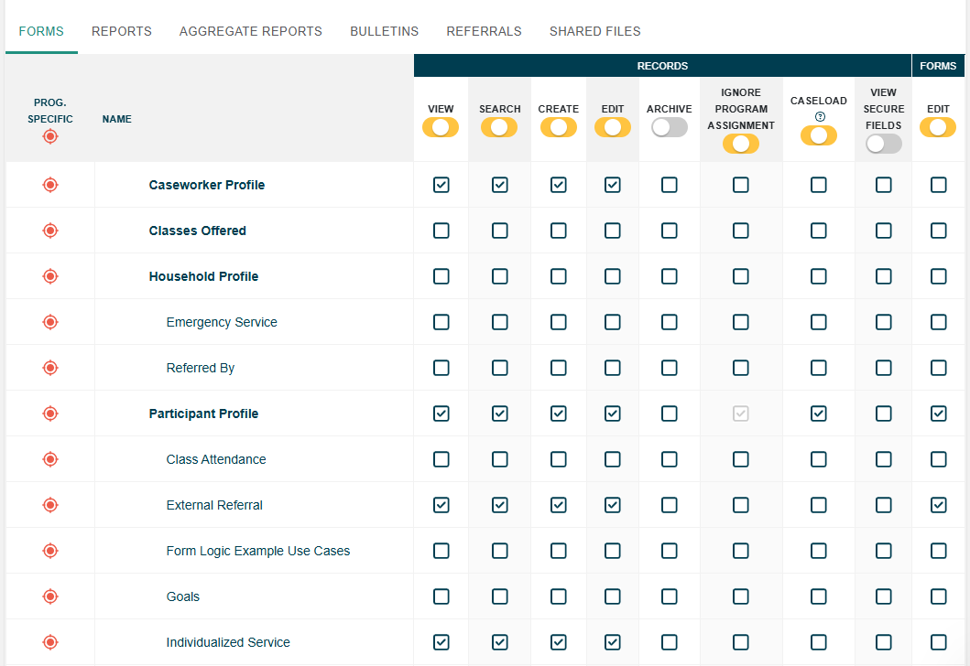
User Management
Sites & Programs
Structure for organizing data & controlling user access (digital file cabinet).
Role Based Permissions
Latest version of assigning access to view / create / edit records, reports & more.
Caseloads (RLA)
Most strict level of access, assigning specific staff to individual Participants.
Notes:
Lesson: Review of User Management topics
Speaker Notes:
Supporting your users as an Admin is an ongoing job, and that includes how they access the system.
You are in charge of organizing the structure of your Apricot with Sites and Programs.
You’ll need to know how to set up and maintain the Roles that allow users to access and handle data.
And there are additional features like Caseloads that help you get more granular with your permissions.

Slide 20
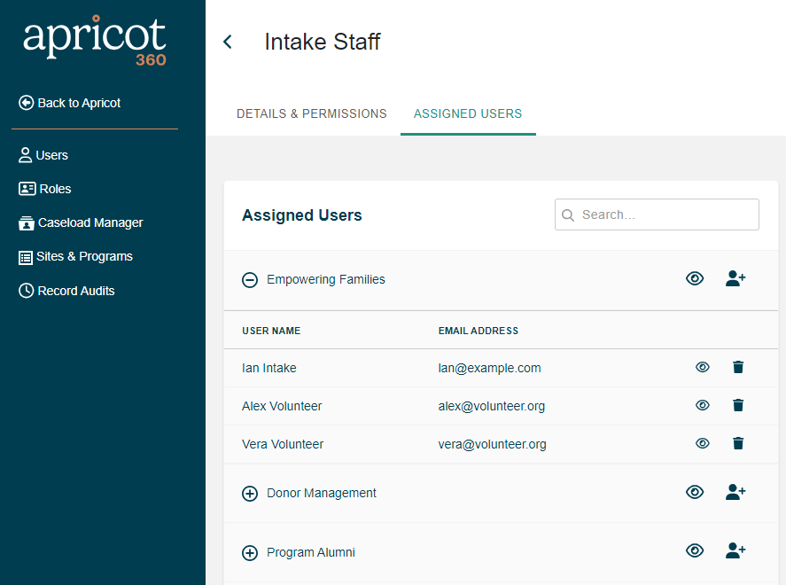
User Management
Managing Users
Create individual named users for each staff.
Manage access & data security via Roles.
Advanced Access
Permissions in between full Admin & Standard User to allow for support with Admin activities.
Administrators
Advanced Access & Site Admins
Standard
Users
Notes:
Lesson: Review of User Management topics
Speaker Notes:
It’s also important to understand what steps are required as new users come and previous users go.
For those of you who want some staff to have special permissions and help you out, we recommend getting familiar with the different types of permissions, included Advanced Access.

Slide 21

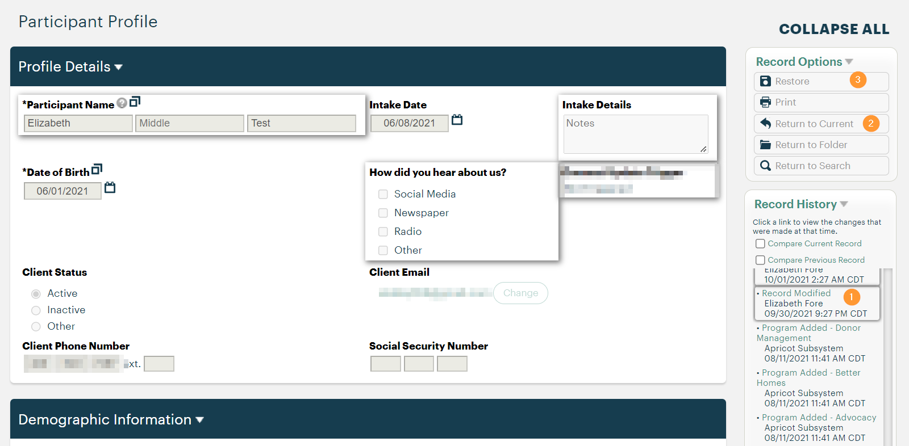
Data Management
Record Audit
Overall view of user activity in your database, including records created, modified, archived, etc.
Track how your data is being accessed & edited.
Use for coaching users on best practices.
Record History
Individual record activity with option to compare modifications & restore past versions.
Archiving Records
Closest option to deleting records.
Can be restored, one record at a time.
Notes:
Lesson: Review of Data Management topics
Speaker Notes:
Shifting into Data Management, while your users may do most of the data entry, it’s important as an Admin to keep an eye on quality.
Understanding the Record Audit tool will give you the power to track activities across your Apricot by different users, whether your need to report on how your data is accessed or you just want to coach users.
The Record History will help you manage individual records and perhaps correct mistaken changes.
And you will likely be called upon to Archive and restore records.

Slide 22

Additional Features
Workflows – Pre-built path of forms to complete by Program or situation.​
Bulletins – Announcements, reports, resources & more featured on home page.
Schedule – Calendar integration to view & book appointments with Participants.​
Rules & Alerts – Surfacing notifications for urgent situations or action required.​
Intake Forms – External version of Tier 1 forms (Application, Referral, Request).​
Connect – Portal to access forms & messaging for existing Participants.​
Inventory – Tracking distribution of physical assets like Beds, Technology, Clothing.​
Notes:
Lesson: Review of additional features Admins might set up for their staff.
Speaker Notes:
Last, but not least, let’s talk about some of the additional features you may enable to support your organization. This list will likely grow as we have new releases, so expect to see questions about those in your recertification quizzes.
You might use Workflows to walk your staff through a set of forms instead of having to keep reminding them what steps to take.
Bulletins allow you to post announcements, key training resources and more for your users to reference.
Schedule is a great tool if you want to book appointments between staff and participants in Apricot.
Rules & Alerts allow for another type of automation if there are situations that bear surfacing for more immediate action.
Then Intake and Connect allow for external access to Apricot to take some of the data entry burden off of your staff, but also to involve your key stakeholders in the process, from Participants to Referral partners to Volunteers and more.
For those of you who help Participants with physical resources, there’s also the Inventory feature.

Slide 23
Recommended Training
Notes:
Speaker Notes:
As you can see, there are many areas that we recommend a Certified Admin know and understand to successfully manage Apricot.
Going through this list, I hope you feel confident about what you know or what areas you might want to refresh before taking the exam.
Let’s go into some recommended training so you know what resources are available to you in case you want to study up further.

Slide 24
Comprehensive Training
Foundations
Apricot Admin Foundations or Labs
Foundational Webinars
Advanced
Apricot Admin Masterclass
Advanced Webinars
Supplemental
Private Training
Targeted & New Release Webinars
Paid
Small Groups
More Time for Q&A
Hands-On Activities
Free
Larger Groups
Recordings
Quick Q&A
Self-Guided Practice
Notes:
Lesson: Overview of all Training we currently offer in different categories
Speaker Notes:
For those of you just starting your training journey who want to know beforehand how to prepare for the exam, here is a big picture view of the training available to you. There are two main categories:
We have Paid Training that’s usually smaller groups with plenty of time for hands on and Q&A. This is ideal for those of you that prefer more time with a Trainer.
Then we have free resources available to the larger group. The same information is covered, but it’s often faster paced without hands on for those of you that prefer to do it yourself.
You are welcome to mix and match based on where you feel you need to spend time.
With that said, we recommend that everyone start with the foundations to understand how Apricot works. This includes either our paid multiday course and labs or free webinars on starter topics.
Then when you are ready for more advanced topics, we have a new paid multi-day masterclass or free advanced webinars.
Lastly, we offer supplemental training that’s more nuanced, whether you want paid private time with a trainer to talk about your unique use case or you join our free targeted and new release webinars hosted monthly.

Slide 25
Refresher Training
Pick & choose webinars by topic:
Admin Role | Form Design | Native Reporting
Becoming a Strong Admin Getting Staff Buy-In Preparing Your Apricot for Rollout Understanding Your Apricot Design Optimizing Your Apricot Working with Form & Report Templates | Designing a Profile Form Designing Forms for Tracking Services, Case Notes, Interactions & More Measuring Client Progress via Forms Modifying Forms How to Track Multiple Services in One Form Making Forms Relevant with Conditional Questions How to Create Dynamic Dropdowns Creating Surveys & Assessments | Extracting Your Data Analyzing Your Data with Report Filters Troubleshooting Your Report Adding Summaries to Reports Building Reports with Multiple Forms Using Graphs in Reporting When to Use Results Reporting Gaining Insight from Survey & Assessment Data
Notes:
Lesson: Review of webinars recommended to refresh on specific topics
Speaker Notes:
Perhaps you’ve gone through the various Foundations and Advanced trainings, and now you are ready to take the exam.
If anything we covered in today’s course stood out as something you need to revisit, here is a collection of webinars by topic to help you brush up.
These are all available on our website with live sessions and recordings to meet your needs.
Please let me know any specific recommendations you might be seeking.
LINK to share: https://www.bonterratech.com/training#apricot

Slide 26
Refresher Training
Pick & choose webinars by topic:
User Management | Data Management | Additional Features
Managing Your Sites & Programs Supporting New Users Streamlining Staff Access to their Caseload How to Migrate to Role Based Permissions Granting Standard Users Advanced Permissions | Uploading Data into Apricot Troubleshooting Your Data Upload Keeping Data Organized & Secure | Options for Tracking Attendance Setting Up Participant Portal Managing Inventory in Apricot Tracking Internal & External Referrals Streamlining Staff Workflow Helping Users Prioritize Key Tasks in Apricot
Notes:
Lesson: Review of webinars recommended to refresh on specific topics
Speaker Notes:
Additional webinars by topic area
LINK to share: https://www.bonterratech.com/training#apricot

Slide 27
Knowledge Check
Notes:
Speaker Notes:
We’ll dive into questions shortly, but I wanted to offer you the chance to test your knowledge with a few sample questions similar to what you will see on the exam.
Please complete the Zoom quiz and we can review answers for anything unclear.

Slide 28
Quiz Questions
What is unique about data collected on a Tier 1 Participant Profile versus any Tier 2 forms tracking Services, Case Notes, etc.?
  Profile should capture a snapshot at time of intake that isn't updated
  We recommend focusing on data like demographics & contact info that doesn't change as a result of your services
  Expect to fill out a new Profile for each Program Enrollment
  None of the Above
Your organization is considering enabling Connect for Volunteers so they can receive messages about upcoming events and log data. Which of the below is an example of a form you might have volunteers fill out via the portal?
  Participant Evaluation
  Individual Service
  Volunteer Timesheet
  Household Enrollment
True or False: Editing the answer choices included in a Lookup List will apply to any field where this list is in use, specifically when entering new records and/or revising previous ones.
Your organization specializes in individual counseling and family therapy. What data might you collect in a Tier 2 underneath a Household Tier 1 Profile versus a Participant Tier 1 Profile?
  Services Provided to the Household
  Services Provided to Individual Members
  Parent or Guardian Consent Forms
  Demographics for Children
True or False: Inventory Management in Apricot can only track items you distribute to specific named Participants.
You are hoping to show improvement over time with Pre and Post Scores on a Soft Skills Assessment for your Workforce Program. When building a Comparison Report in Native Reporting, which date field does Apricot rely on to know which record is Pre and which is Post?
  Any Date Field
  Created Date
  Modified Date
  First Date Field
Notes:
*Slide hidden in case you use quiz feature in Zoom to ask questions. Next slide has answers.

Slide 29
Quiz Answers
What is unique about data collected on a Tier 1 Participant Profile versus any Tier 2 forms tracking Services, Case Notes, etc.?
  Profile should capture a snapshot at time of intake that isn't updated
  We recommend focusing on data like demographics & contact info that doesn't change as a result of your services
  Expect to fill out a new Profile for each Program Enrollment
  None of the Above
Your organization is considering enabling Connect for Volunteers so they can receive messages about upcoming events and log data. Which of the below is an example of a form you might have volunteers fill out via the portal?
  Participant Evaluation
  Individual Service
  Volunteer Timesheet
  Household Enrollment
True or False: Editing the answer choices included in a Lookup List will apply to any field where this list is in use, specifically when entering new records and/or revising previous ones.
Your organization specializes in individual counseling and family therapy. What data might you collect in a Tier 2 underneath a Household Tier 1 Profile versus a Participant Tier 1 Profile?
  Services Provided to the Household
  Services Provided to Individual Members
  Parent or Guardian Consent Forms
  Demographics for Children
True or False: Inventory Management in Apricot can only track items you distribute to specific named Participants.
You are hoping to show improvement over time with Pre and Post Scores on a Soft Skills Assessment for your Workforce Program. When building a Comparison Report in Native Reporting, which date field does Apricot rely on to know which record is Pre and which is Post?
  Any Date Field
  Created Date
  Modified Date
  First Date Field
Notes:
Lesson: Sampling of questions similar to Exam for practice.
Speaker Notes:
Now that you all have tried your hand at some sample questions to get familiar with what to expect on the Apricot Certification Exam, let’s check your answers.
*Read each question and then click to reveal the correct answer. The below notes are context on our reasoning for correct answers if needed.
We recommend focusing on data like demographics & contact info that doesn't change as a result of your services – Tier 1 should be filled out once and kept up to date. Tier 2s are the place for tracking change over time, history, progress, counts, etc.
Volunteer Timesheet – The other forms would be associated with Participants and Connect only allows you to access and enter data about yourself, so for Volunteers that would be their own data about their time spent in a given activity.
True – Lookup lists are edited in one place, but the changes apply anywhere they are used. This won’t change already selected answers (unless you edit existing records), but it does impact what you can choose for new records.
Services Provided to the Household – This is what should live under a Household Tier 1. The other forms listed here would most likely be under a Participant Tier 1 since they refer to specific individuals, not the full household.
False – Inventory can also be used to track items distributed to anyone without names as long as it’s items that are not to be returned since you don’t necessarily need to know who has those items.
Created Date – Comparison Reporting uses Limits and Aliases which rely on the Created Date for the records. If you need a different date for the comparison you would need to create a different type of report or consider Results Reporting.

Slide 30
Q&A
Notes:
Speaker Notes:
Alright, now it’s time for questions.
Feel free to ask anything on your mind for the exam, whether it’s about what to expect or Apricot functionality.
We will do our best to answer here or recommend resources for further research.

Slide 31

Q&A
Ask questions about functionality
Ask trainer to demo features
Ask real-life application questions
Notes:
Speaker Notes: Open up to any questions folks have about Apricot. Do you best to respond of point to resources. It may help to have list of webinars open to suggest for more detailed review of topic areas asked about.

Slide 32
Closing
Notes:
Speaker Notes:
Thank you all for joining.
We hope you feel more confident about what to expect with our Apricot Certification Exam.

Slide 33

Training Resources
Knowledge Base – How-To Articles (Search Chat or Visit Online)
Bonterra Academy – Free Webinars & Recordings
Foundations – Intensive, Multiday Courses to Cover Admin Basics
Admin Labs – 2 Hour Live Trainings on Specific Capabilities
Private Training – 1:1 Sessions with Training Expert in Your Apricot (End User & Admin Topics Available)
Build confidence & knowledge in our software!
Notes:
Speaker Notes:
As you go forth and continue your preparations, please keep these resources in mind.
I will share links in the chat for you to bookmark.
LINKs to share:
Apricot Help Center: https://apricot-articles.socialsolutions.com/en/
Apricot Free Webinars: https://www.bonterratech.com/training#apricot
How to Contact Bonterra: https://www.bonterratech.com/contact-us
Email Newsletter Signup: https://learn.bonterratech.com/customer-newsletter-subscriptions.html
Purchase Seats in Paid Trainings: https://bonterraacademy.bonterratech.com/self-signup/index
Bonterra Academy (Training Subscription Access to Paid Classes): https://bonterraacademy.bonterratech.com/
Learn More about Private Training: https://apricot-articles.socialsolutions.com/en/articles/8952258-apricot-private-training-menu

Slide 34
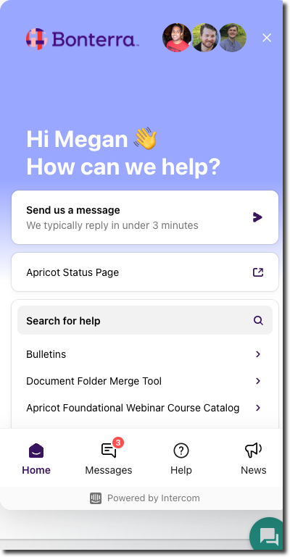
Customer Support
Reach out to our Customer Support Team with Questions or Concerns.
Weekdays 7am – 7pm CST via chat or through email: apricot@bonterratech.com
Notes:
Speaker Notes:
If there is anything we couldn’t answer for you today or you think of a question after this session, please feel free to contact our Support team via chat or email.

Slide 35
Thank you!
Good luck on your exam!

